Slide 1


Basic Details of the Team and
Problem Statement
Problem Statement Title
: Revolutionizing Research Collaboration and Discovery
Team Name
: Syntax_Survivors (SR-13)
Team Leader Name:
Riya Shigvan
PS : 2 (Senior Track)
Problem Statement : The research community faces challenges in discovering relevant work, accessing reliable datasets, and collaborating across disciplines due to fragmented resources and a lack of integrated networking tools. Traditional platforms do not effectively facilitate seamless research discovery, interdisciplinary collaboration, or real-time knowledge sharing, leading to inefficiencies and missed opportunities.
Institute Name
: Vivekanand Education Society's Institute of Technology

Slide 2


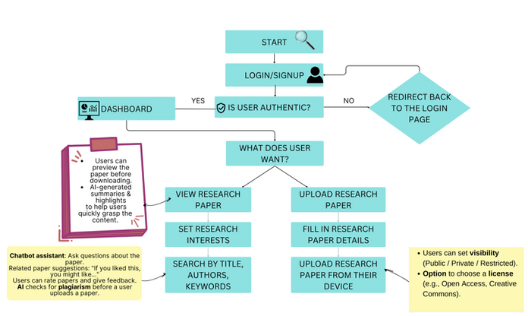
2
Idea / Approach Details
Idea : CogniTerra
CogniTerra is an AI-driven research assistant that helps researchers and enthusiasts efficiently discover, manage, and share academic papers.
1.
The AI model, integrated via API, recommends relevant research papers based on user interests, citations, and trending topics in their field.
2.
Users can upload and share their own research papers, ensuring wider visibility while maintaining authenticity and credibility.
3.
A personalized dashboard allows users to track engagement, manage their library, and receive AI-driven insights for their research.

Slide 3


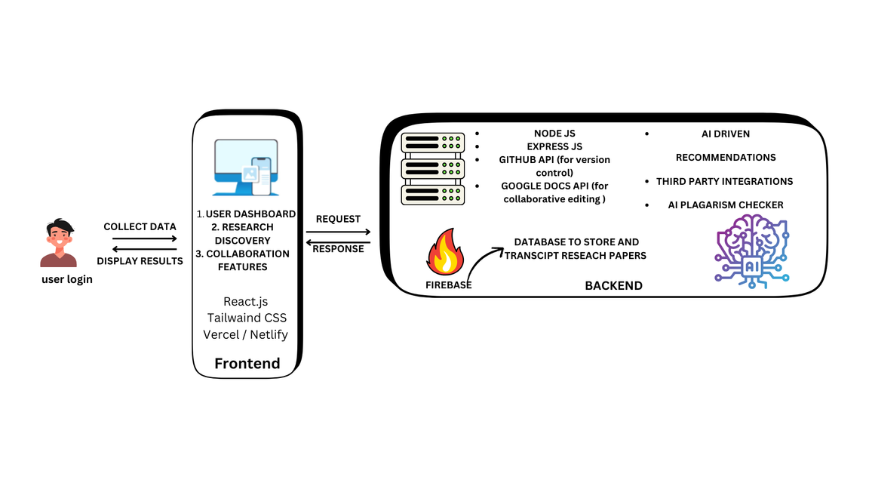
System Architecture
3
Tech Stack
Dependencies
YoORCID API – Verifies researcher identity and academic credentials before allowing paper publication.
Turnitin API – Ensures research integrity by detecting plagiarism and AI-generated content in submitted papers.
CrossRef API – Assigns DOI to published papers and retrieves citation metadata for research indexing.
Front-End :
React.js, Tailwaind CSS, Vercel / Netlify
Back-End :
Node.js, Express.js
Database : Machine learning :
Firebase, PostgreSQL
spaCy, NLTK, Pytorch, Python Libraries
Cloud Platform:
AWS

Slide 4



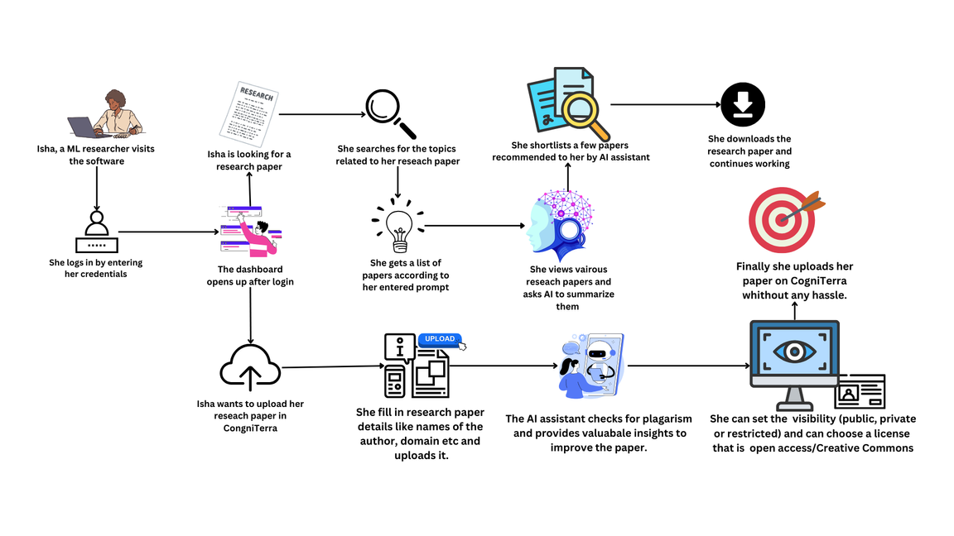
4
Use-Case
Video Link :

Slide 5

5
Team Member Details
Team Leader Name: Riya Shigvan
BE
AIDS
Year III
Team Member 1 : Tanisha Pradhan
BE
AIDS
Year III
Team Member 2 Name : Parth Wanjari
BE
AIDS
Year III
Team Member 3 Name : Shlok Nandanwar
BE
AIDS
Year III

